Slide 1
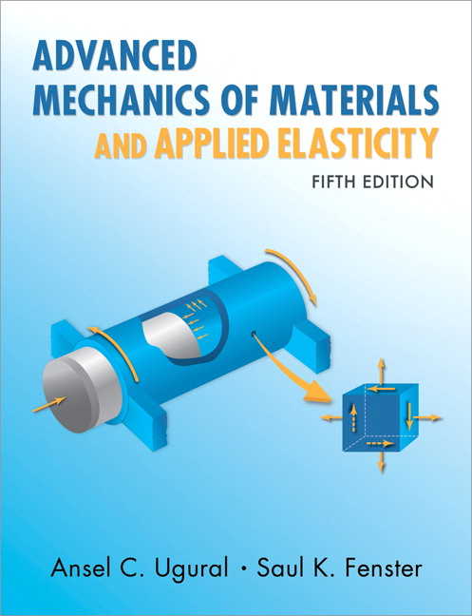
Advanced Mechanics
(Lecture 26 & 27)
ANNOUNCE / BUSINESS
HW 13 (due Today)
HW Extra (due Tu, 4/22) Course feedback
HW 14 (due Th, 4/24)
PREVIOUS
Buckling
TODAY
Plasticity Axial (assembly) Bending Torsion

Slide 2
HW Extra
********************************************************** To get the extra credit: Upload a screenshot of the completion page for the student course evaluation feedback to gradescope.
Due by 11:59 PM on Tuesday 04/22
The final completion page ONLY Do NOT upload your choices or feedback comments, which are confidential

Slide 3
HW Extra
Course feedback - What we care about as instructors: We strive to constantly improve our courses, and the feedback we get from students through these evaluations is very helpful. Comments on things you like / dislike are especially appreciated! My promise: I will carefully read every word in your feedback comments.
********************************************************** To get the extra credit: Upload a screenshot of the completion page for the student course evaluation feedback to gradescope.
Due by 11:59 PM on Tuesday 04/22
The final completion page ONLY Do NOT upload your choices or feedback comments, which are confidential

Slide 4

HW Extra
Course feedback - What the university cares for admin purposes: (Your chance to give Pass/Fail to your professors)
Pass
Fail

Slide 5
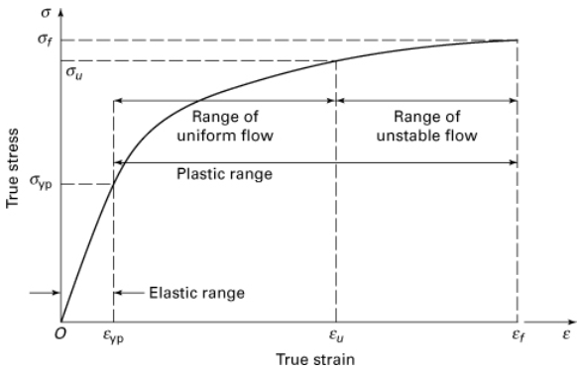
Plasticity
Inelastic material behavior – permanent distortion upon complete unloading (will focus on this in upcoming lectures)
Equations of equilibrium, conditions of compatibility, and strain-displacement relations still apply, but we need new stress-strain relationships

Slide 6
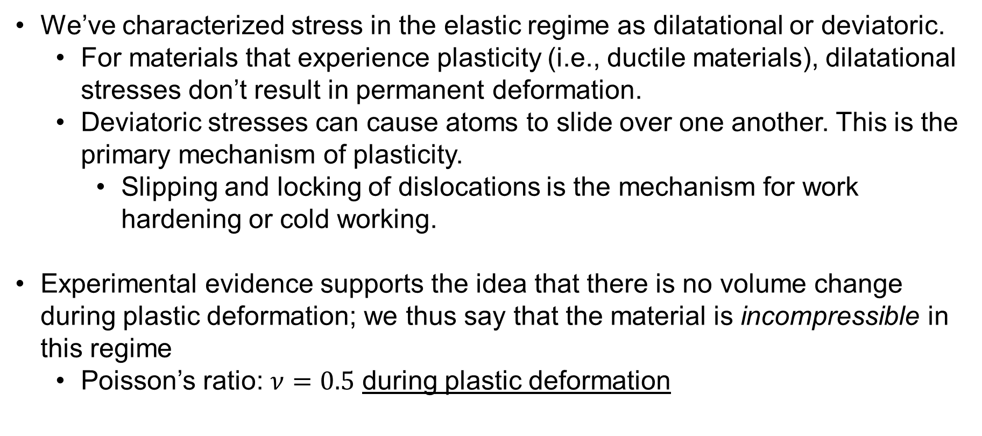
Plastic Deformation Concepts
We’ve characterized stress in the elastic regime as dilatational or deviatoric.
For materials that experience plasticity (i.e., ductile materials), dilatational stresses don’t result in permanent deformation.
Deviatoric stresses can cause atoms to slide over one another. This is the primary mechanism of plasticity.
Slipping and locking of dislocations is the mechanism for work hardening or cold working.
Experimental evidence supports the idea that there is no volume change during plastic deformation; we thus say that the material is incompressible in this regime
Poisson’s ratio: $ν=0.5$ during plastic deformation

Slide 7
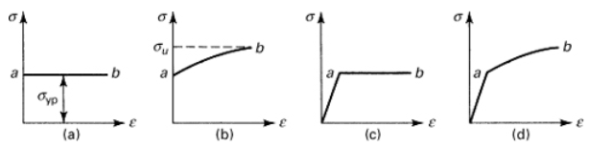
Stress-Strain Relationship
Analysis of plasticity typically utilizes idealized models:
(a) rigid, perfectly plastic
(b) rigid-plastic
(c) elastic, perfectly plastic
(d) elastic-plastic
(a) and (c) are suitable for materials like mild steel, clay, and nylon, which exhibit large plastic deformations at relatively constant stress

Slide 8
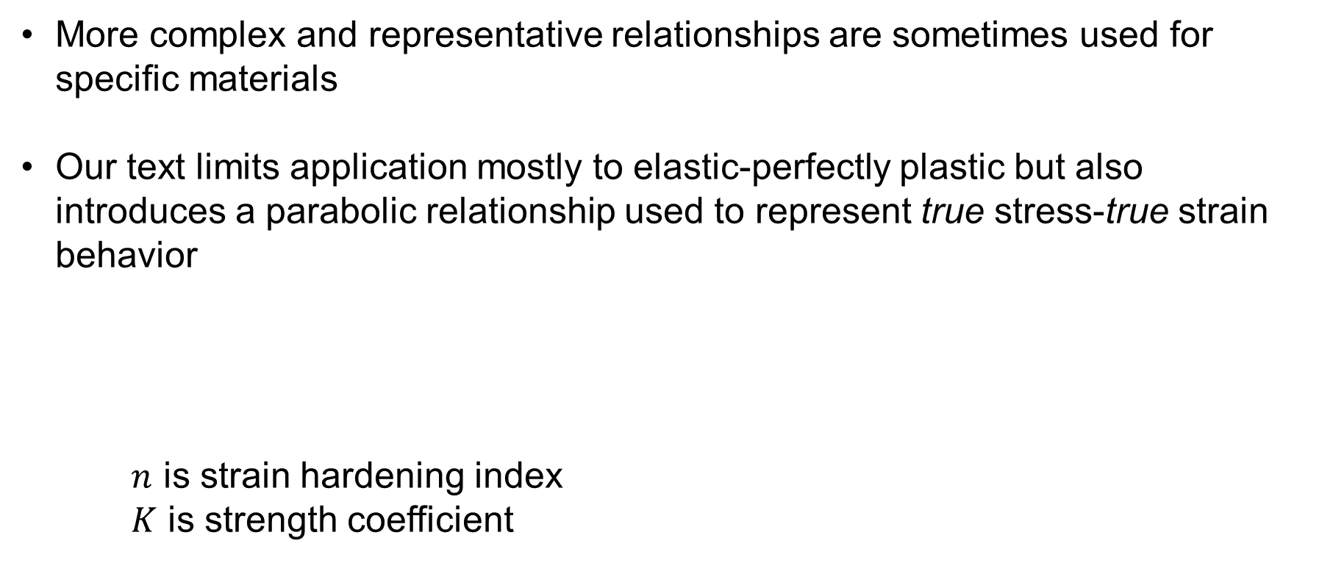
Stress-Strain Relationship
More complex and representative relationships are sometimes used for specific materials
Our text limits application mostly to elastic-perfectly plastic but also introduces a parabolic relationship used to represent true stress-true strain behavior
$n$ is strain hardening index
$K$ is strength coefficient

Slide 9
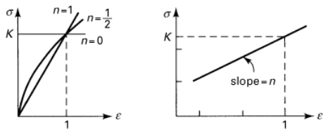

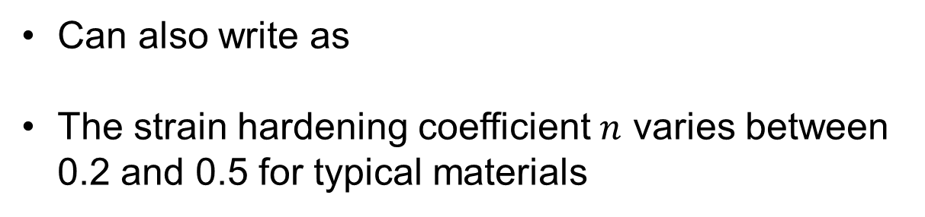
Stress-Strain Relationship
Can also write as
The strain hardening coefficient $n$ varies between 0.2 and 0.5 for typical materials

Slide 10
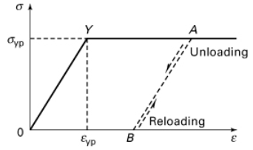
Residual Strain and Residual Stress
Plastic deformation, by definition, results in residual strains after unloading, but it can also lead to residual stresses when parts of a structure experience different extents of plasticity prior to release of load

Slide 11
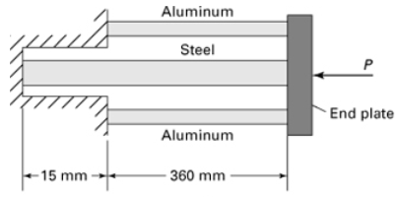
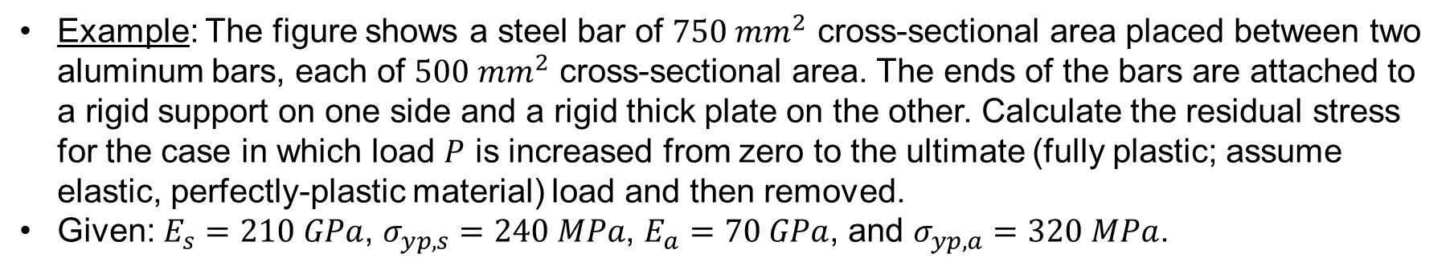
Residual Stress
Example: The figure shows a steel bar of $750 {mm}^{2}$ cross-sectional area placed between two aluminum bars, each of ${500 mm}^{2}$ cross-sectional area. The ends of the bars are attached to a rigid support on one side and a rigid thick plate on the other. Calculate the residual stress for the case in which load $P$ is increased from zero to the ultimate (fully plastic; assume elastic, perfectly-plastic material) load and then removed.
Given: $E_{s}=210 GPa$, $σ_{yp,s}=240 MPa$, $E_{a}=70 GPa$, and $σ_{yp,a}=320 MPa$.
I solved this opposite from the text!

Slide 12
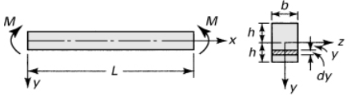
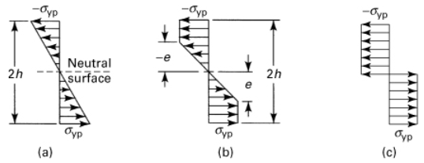
Plasticity in Bending
Consider elastic, perfectly-plastic behavior (could also consider work hardening material) under pure bending

Slide 13

Plasticity in Bending
Consider elastic, perfectly-plastic behavior (could also consider work hardening material) under pure bending

Slide 14
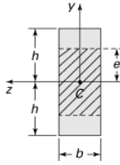
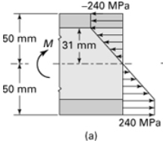
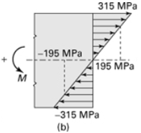
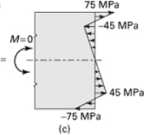
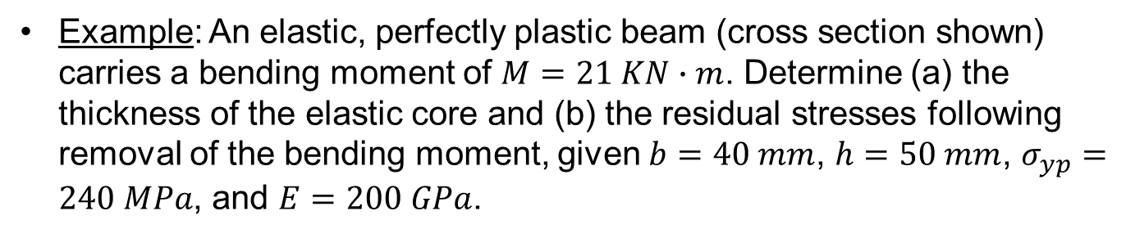
Residual Stresses in Bending
Example: An elastic, perfectly plastic beam (cross section shown) carries a bending moment of $M=21 KN∙m$. Determine (a) the thickness of the elastic core and (b) the residual stresses following removal of the bending moment, given $b=40 mm$, $h=50 mm$, $σ_{yp}=240 MPa$, and $E=200 GPa$.

Slide 15

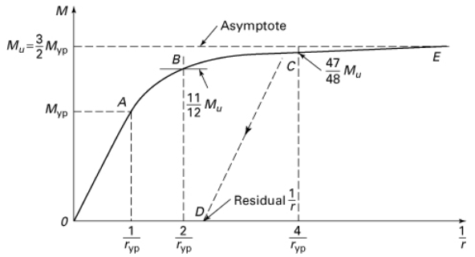
Moment-Curvature Relationship

Slide 16
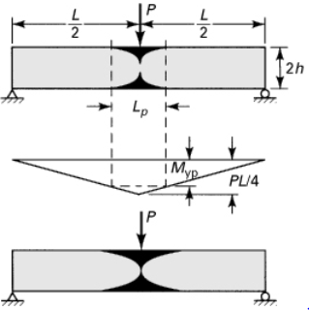
Plastic Hinge

Slide 17
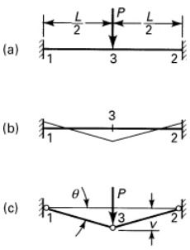



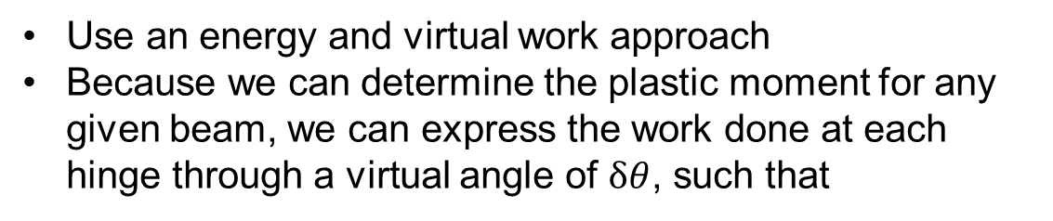
Collapse Load – Limit Design
Elastic design permits no yielding
Structures may achieve higher loads if some yielding is permissible
Limit design: determine load required to develop plastic hinge
Use an energy and virtual work approach
Because we can determine the plastic moment for any given beam, we can express the work done at each hinge through a virtual angle of $δθ$, such that
Using geometry, we see that
Substituting gives …
Notes:
Note that while the moment is not the same at each location during elastic deformation, a hinge will not develop until all points reach Mu.

Slide 18
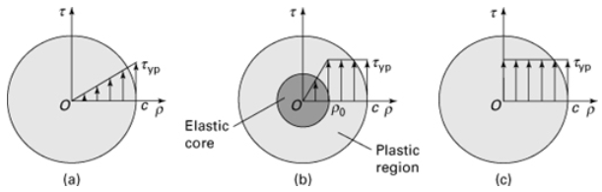






Elastic-Plastic Torsion
Elastic
Plastic
Total
Onset of yielding
$$Lγ_{yp}=cφ_{yp}$$
Post-yielding
$$Lγ_{yp}=ρ_{o}φ$$

Slide 19

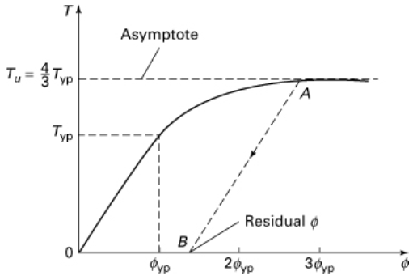
Elastic-Plastic Torsion

Slide 20
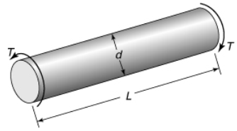
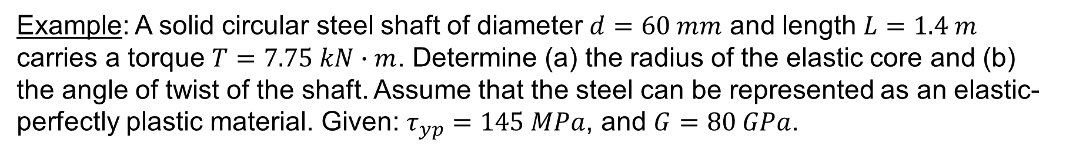
Example: A solid circular steel shaft of diameter $d=60 mm$ and length $L=1.4 m$ carries a torque $T=7.75 kN∙m$. Determine (a) the radius of the elastic core and (b) the angle of twist of the shaft. Assume that the steel can be represented as an elastic-perfectly plastic material. Given: $τ_{yp}=145 MPa$, and $G=80 GPa$.

